Slide 1


Fogli Fideuram
A Front End prototype

Slide 2
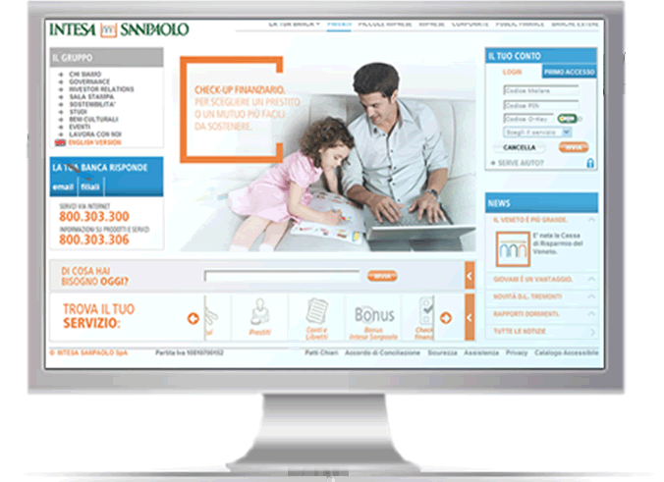



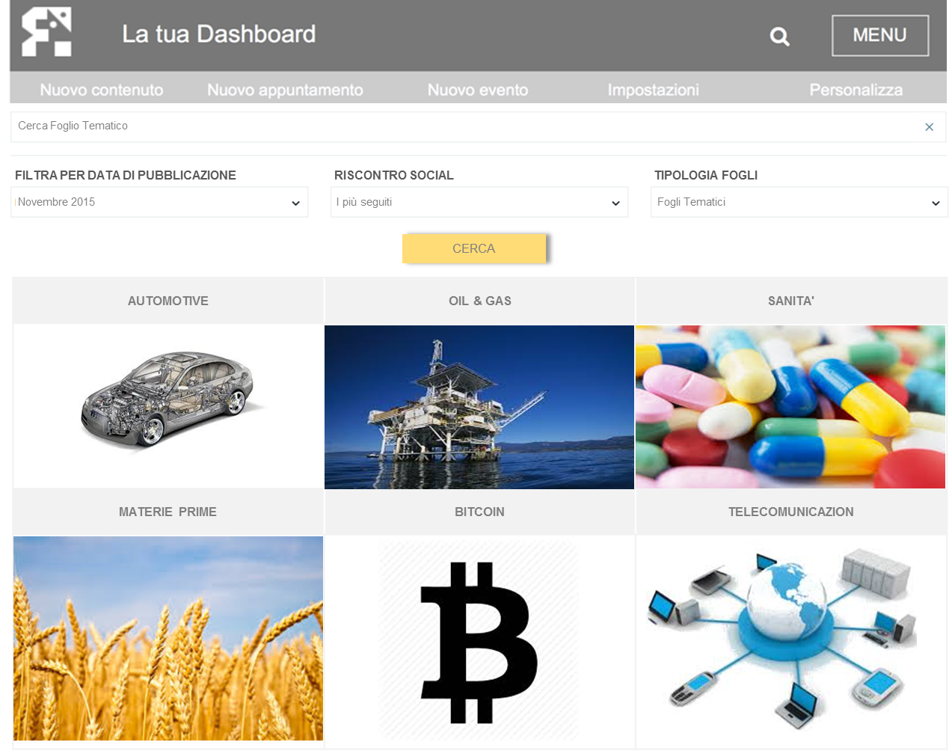
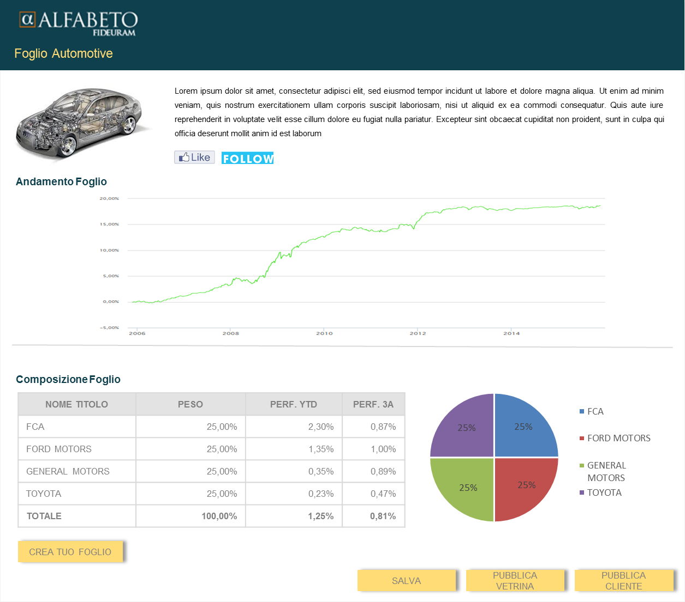
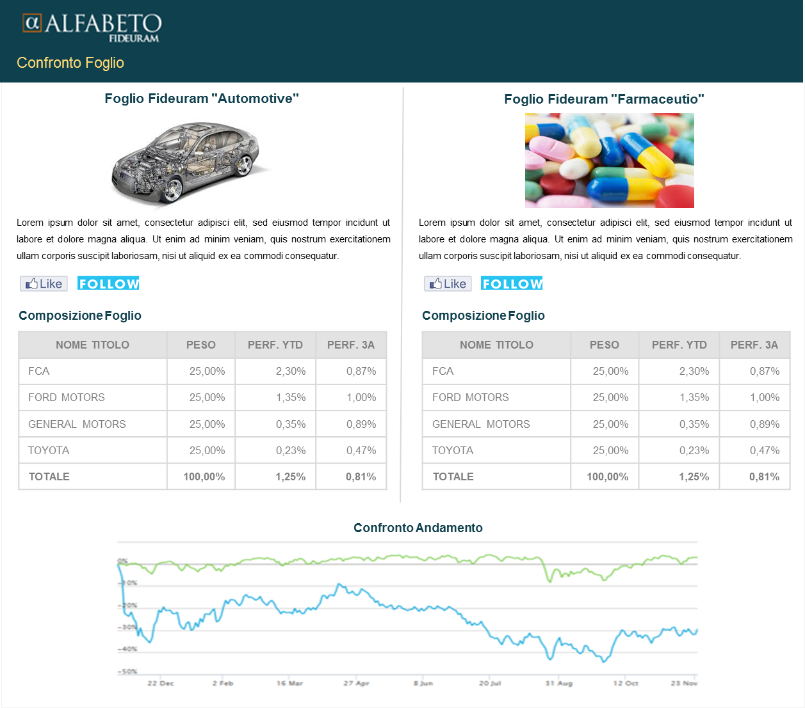
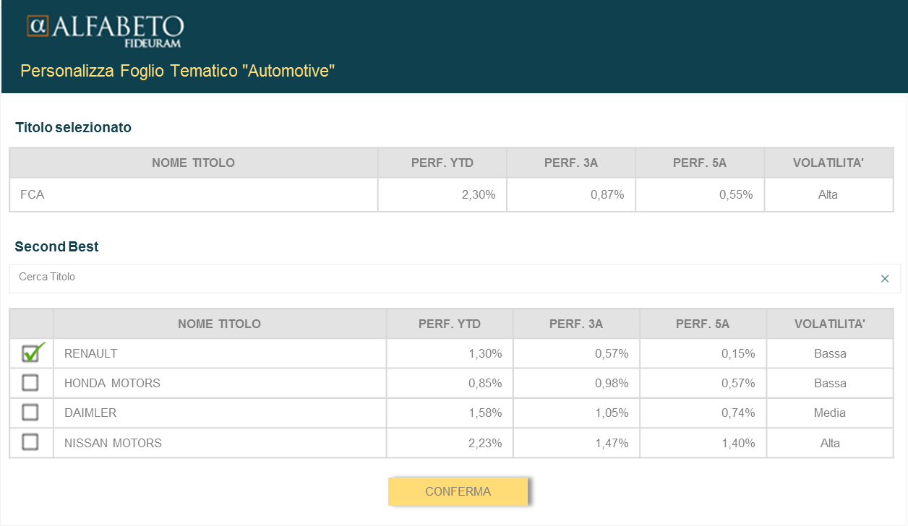

Where we started from
What we wanted to build
The genesis
The high level pre-sale process for Fogli presented in December
A web FE built with Angular2 components implementing the process and …
Why
LISTA FOGLI
SCHEDA FOGLIO
VISTA PB
… consuming REST services provided by a Server …
… adopting production quality patterns and styles
CONFRONTO FOGLI
SIMULAZIONE
FOGLIO
Prove on a real life scenario the key advantages promised by the trendiest web architectures:
Reusability of components
Simplified and rapid development
Improvement of performances (qualitative test)
A further key advantage (mobility-first design, automatic testing) are out of scope for this prototype
with some inspiration from the Motif team

Slide 3
Client
Server
The architecture of the prototype
Angular2 Beta* framework with its major services:
WebComponent support
Event driven programming
Routing
Http client and async calls from within the WebComponents
Express and NodeJS to implement the REST server
Mongoose/MongoDB as nonSQL DB
Typescript/Javascript for OO design and development (as suggested by Angular2 team)
Additional Javascript libraries for specific tasks
Highcharts for Charts
NoUISlider for Slider
The server side is an ancillary component aimed simply at providing a real REST interface for the Client and is not to be considered as of the prototype (considering also that Fideuram will use different back-end systems and architectures)
MS Visual Studio Code as lightweight IDE
All SW components used are open source (with the exception of Highcharts which can be substituted by other charts lib)
“Beta means we're now confident that most developers can be successful building large applications using Angular 2.”
(source: http://angularjs.blogspot.it/2015/12/angular-2-beta.html)

Slide 4
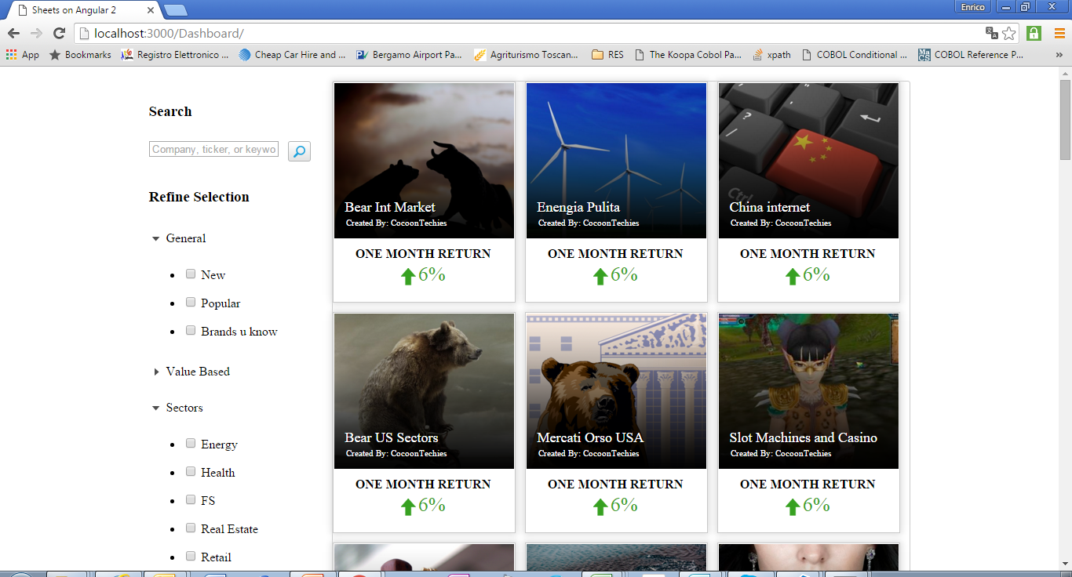
Fogli Dashboard – the first composite page
Container
Collection
Rest services
retrieve the selection criteria
search (per selection criteria) and retrieve Fogli summary info
Search Bar
Search conditions (repeated)
Fogli Summary (repeated)
Rest services
retrieve list of Fogli summary info

Slide 5
Reuse of components
A first example of reuse of components is provided by the Dashboard page itself with the repetition of the ‘Search Condition’ and ‘Fogli Summary’ components
Search conditions (repeated)
Fogli Summary (repeated)

Slide 6
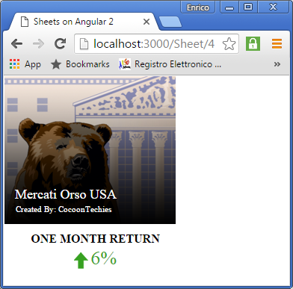
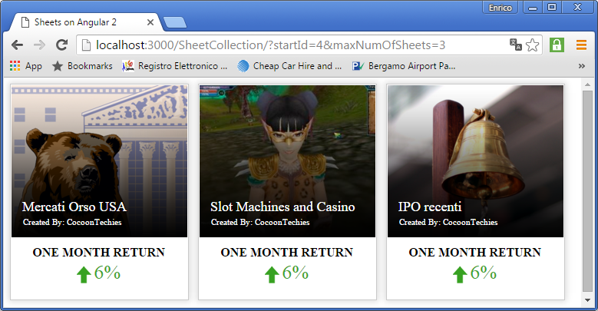
Reuse of components
Components can live also as stand-alone web applications (see screenshots below) or can be imported in other master applications (host apps)
Could be used within a Portal that wants to show the ‘top sellers’ Fogli
Collection (standalone)
Fogli Summary (standalone)
Could be integrated in an application that wants to show the ‘Foglio of the Day’
Each ‘Foglio Summary’ component knows how to load its ‘Foglio Details’ view

Slide 7
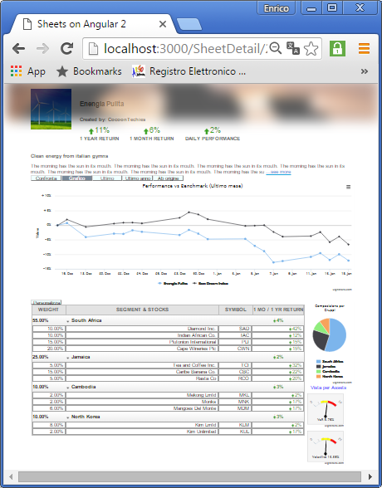
Fogli Details – another composite page
Container
Sheet Info
LongShortText
Fogli Charts
Rest services
retrieve Fogli details
retrieve Return data info
Composition Charts
Asset Composition
Gauge Charts (repeated)

Slide 8
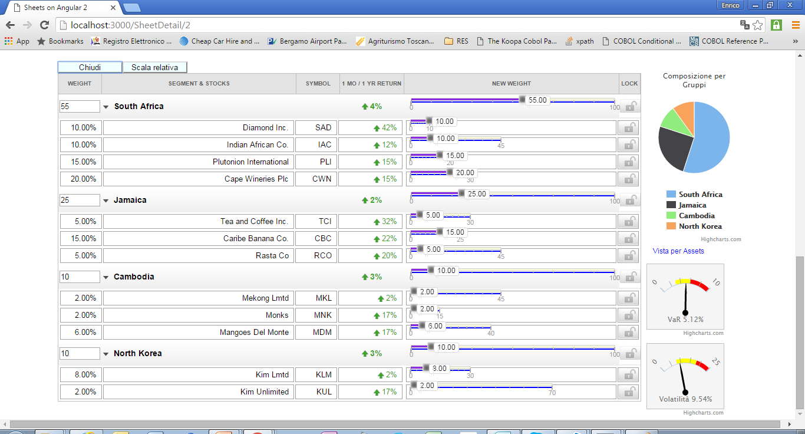
Fogli Simulation– event driven logic in the browser
Asset Composition
Component based sliders (repeated)
Chart components (repeated)
Rest services
rules for composition (min-max) retrieved with the details of Foglio
backend called to update financial data once the simulation is completed and the Foglio is re-balanced
no interaction with the backend required during simulation
Each time a slider is changed, an event is raised from the ‘Slider’ component. Such event is caught by:
the container component (‘Asset Composition’ component) that performs the calculations to re-balance the Foglio and updates the table
the various chart components that need to update their view

Slide 9
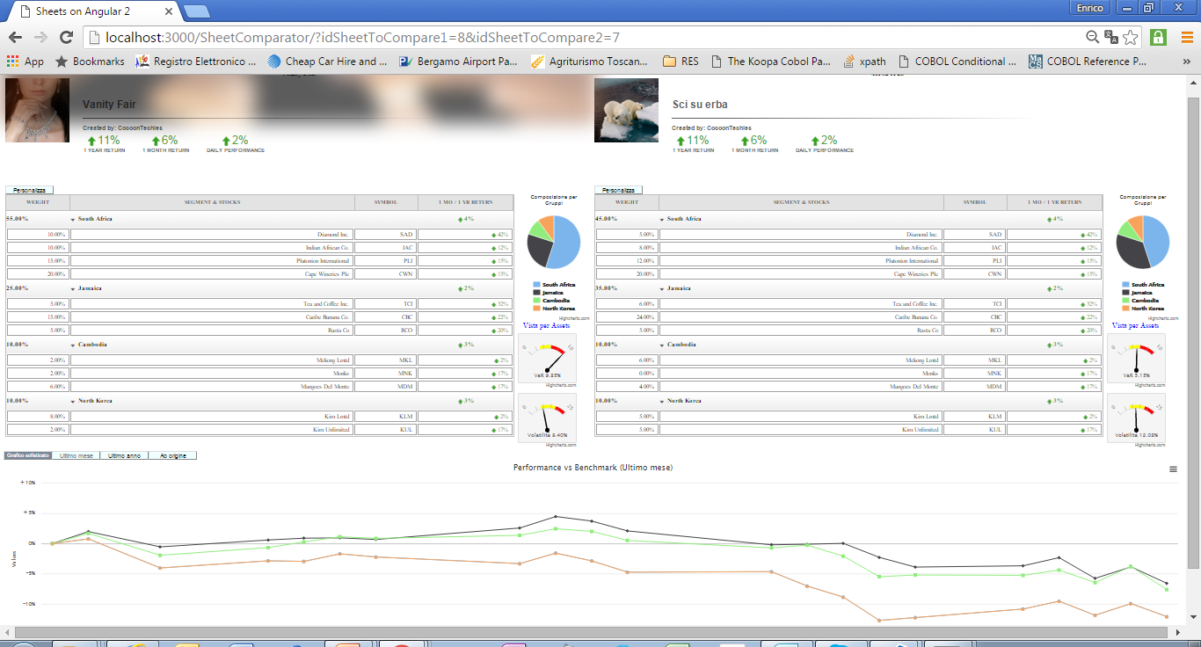
Fogli Comparison– further reuse
Sheet Info
Asset Composition
Fogli Charts
This view is just a composition of WebComponents we have already seen in (and developed for) previous pages

Slide 10
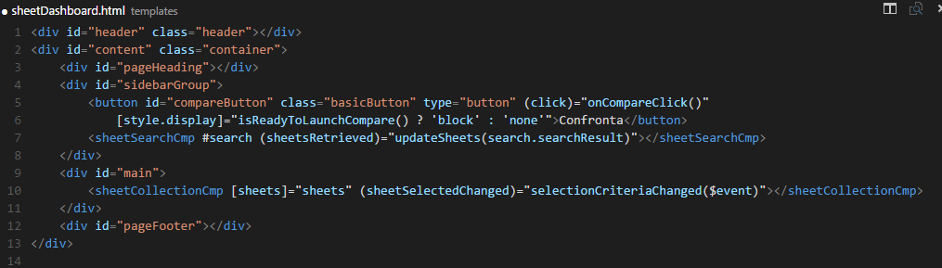
WebComponents in HTML
Input needs to be provided to the component by its container. In this example the ‘Collection’ needs to receive the list of Fogli (here called ‘sheets’) that have to be displayed
The component can also send output to the outside world in form of events which other interested components can subscribe to

Slide 11
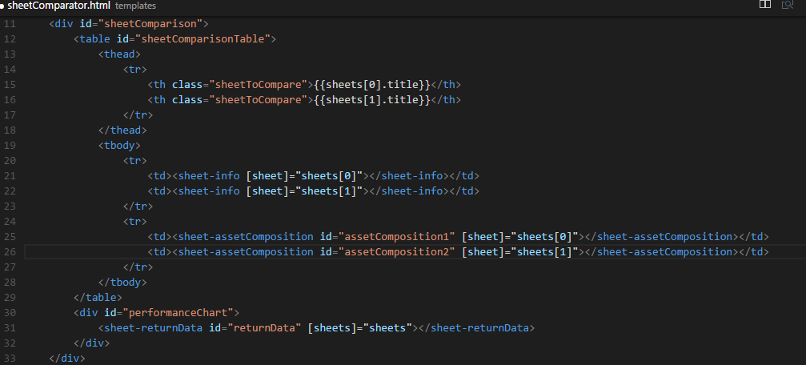
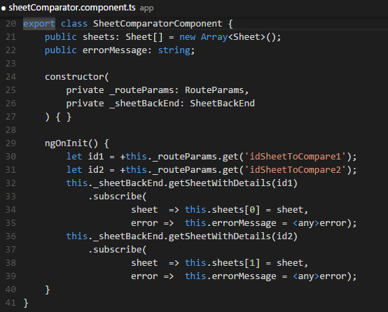
WebComponents in Angular2 – code for Comparator page
To realize the Comparison page we have developed a new component that has only to compose and orchestrate other components already available.
The new component (along Angular2 gudelines) consist of:
One Template (HTML5 enhanced with components)
One Class file (Typescript)
It is possible to appreciate the limited amount of code that needs to be developed to implement a complex function such as comparison. This is made possible by the fact that we heavily leverage a well defined component design.

Slide 12
Why we wanted to develop the Prototype
Conclusions
Prove on a real life scenario the key advantages promised by the trendiest web architectures:
Reusability of components
Simplified and rapid development
Improvement of performances (qualitative)

Slide 13
Appendix

Slide 14
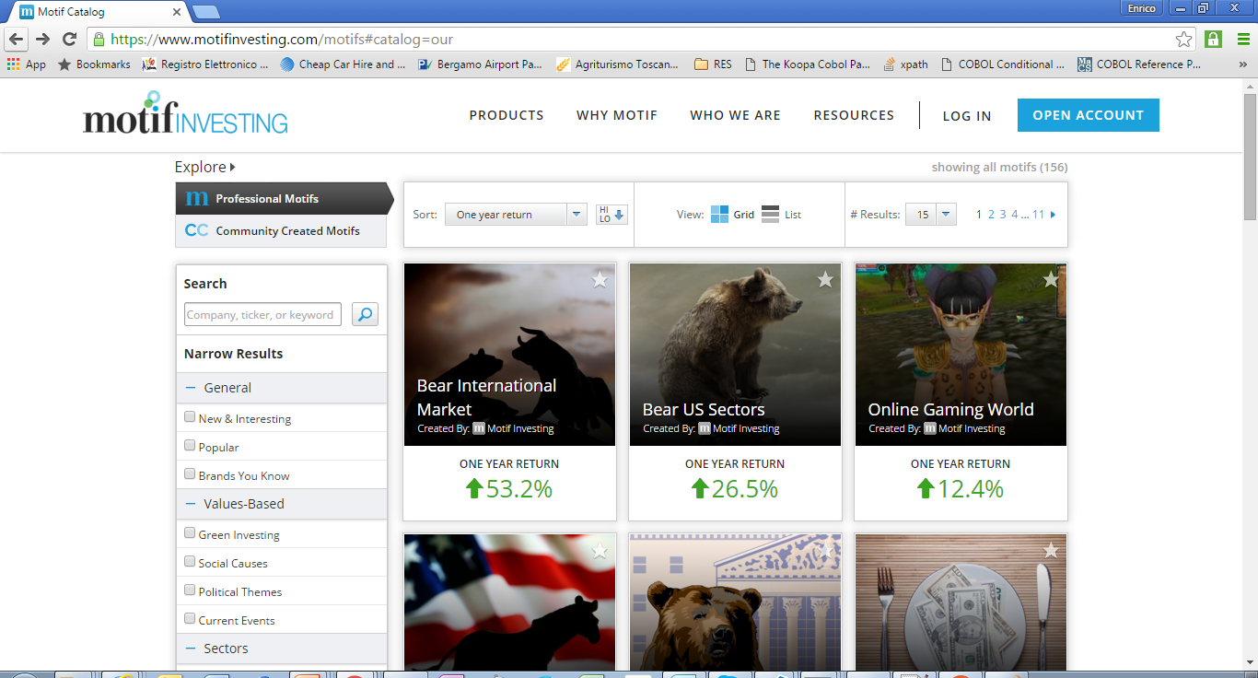
The Catalogue
Appendix – The Motif inspiration

Slide 15
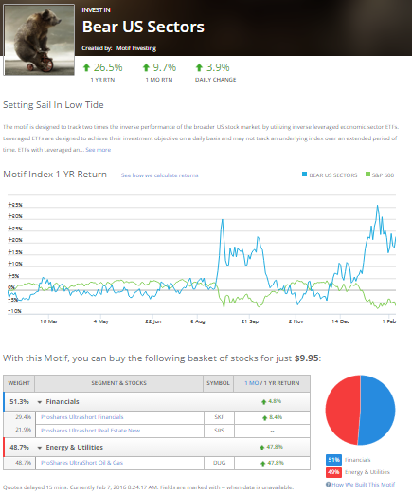
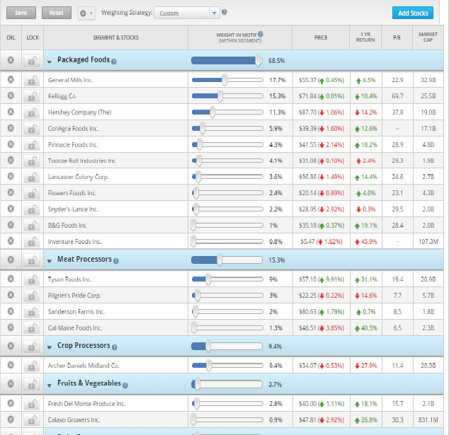
The detailed view
Appendix – The Motif inspiration
The customization view

Slide 16
Fogli Dashboard – the first composite page
LISTA FOGLI
SCHEDA FOGLIO
VISTA PB
CONFRONTO FOGLI
SIMULAZIONE
FOGLIO

